Slide 1
Data Communications

Slide 2
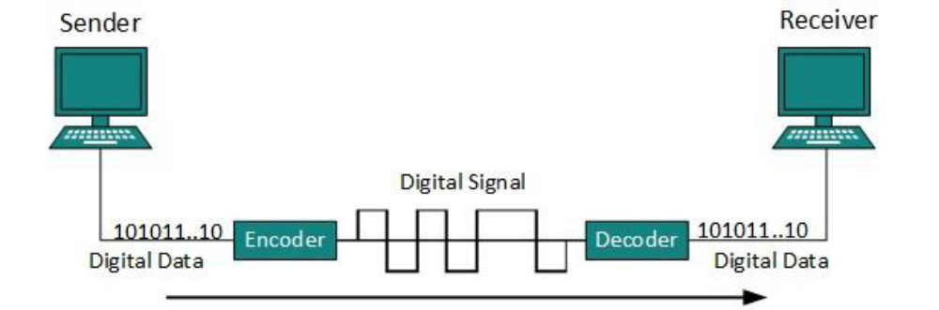
Line Coding
The process for converting digital data into digital signal.
.

Slide 3
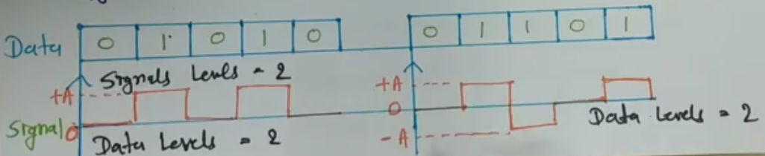
Signal level and Data level
signal level : Number of values allowed in a particular signal. (voltage level)
Data level : Number of values to represent data.
For binary two values 0 and 1.
.

Slide 4
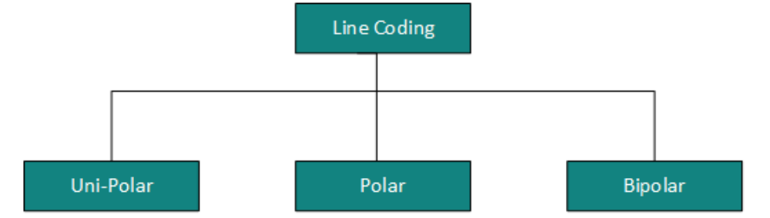
Line Coding
There are three types of line coding schemes available:
.

Slide 5
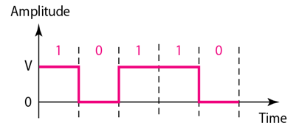
Uni Polar
All the signal levels are on one side of the time axis, either above or below.
Uses single voltage level to represent data.
In this case, to represent binary 1 high voltage is transmitted and to represent 0 no voltage is transmitted.
It is also called Unipolar-Non-return-to-zero, because there’s no rest condition
.

Slide 6
Polar
In polar schemes, the voltages are on both sides of the time axis.
Polar encodings are available in four types:
Polar-NRZ ( Non Return to Zero)
Polar-RZ (Return to Zero)
Manchester
Differential Manchester.
.

Slide 7
BiPolar
Bipolar encoding uses three levels.
ie positive, zero and negative.
Zero level represent binary ‘0’ and alternating positive and negative voltage represents binary ‘1’.
.

Slide 8
Important characteristics of line coding
Signal level and data level.
Pulse rate and bit rate
DC component
Self synchronization
.

Slide 9
Signal level and Data level
signal level : Number of values allowed in a particular signal. (voltage level)
Data level : Number of values to represent data.
For binary two values 0 and 1.
.

Slide 10
Pulse rate and bit rate
Pulse rate : number of pulses per second.
Bit rate : number of bits per second.
If one pulse corresponds to one bit then pulse rate equal to bit rate.
If the pulse carries more than 1 bit, then pulse rate is lower than bit rate.
bit rate = pulse rate X log₂ L
.

Slide 11
DC Component
Over one period cycle of the waveform, if all positive voltages are cancelled by negative voltage the DC component of the waveform is zero.
In line coding, the signal with non zero DC component are treated as distorted one and it can create error in the received signal.
Hence the signal with zero DC components are preferred.
.

Slide 12
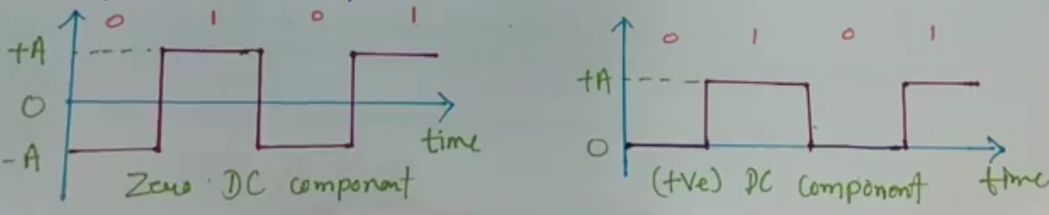
DC Component
.

Slide 13
Self synchronization
There is enough timing information in the transmitted data that keep the sender and receiver synchronized.
.

Slide 14
POLAR-NRZ (NON-RETURN TO ZERO)
It uses 2 different voltage levels – one positive and other is negative.
Voltage level is constant during bit interval.
NRZ scheme has two variants:
NRZ- L
NRZ - I
.

Slide 15
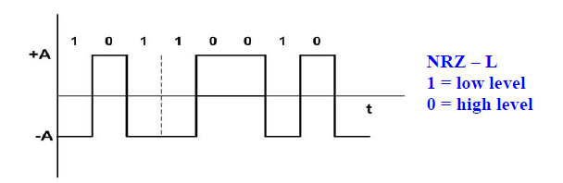
NRZ-L
NRZ-L changes voltage level at when a different bit is encountered
.

Slide 16
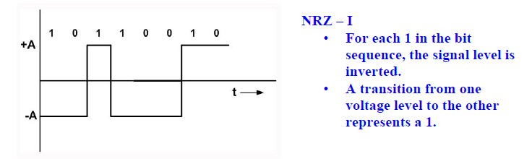
NRZ - I
NRZ-I changes voltage when a 1 is encountered.
.

Slide 17
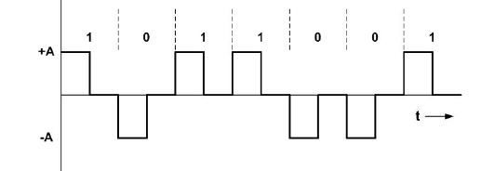
POLAR-RZ (RETURN TO ZERO)
Synchronization is the major concern in previous techniques (NRZ)
To overcome that we can use RZ encoding
Here to ensure synchronization, there must be signal transition in each bit
.

Slide 18
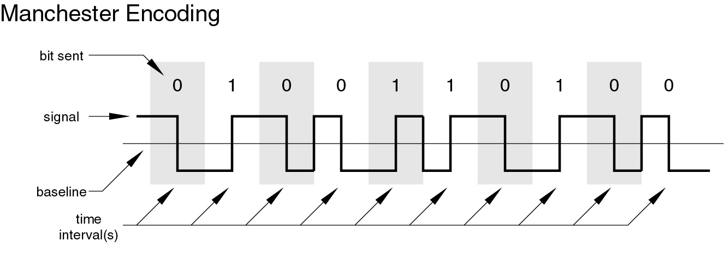
MANCHESTER (Biphase) ENCODING
In the Manchester code, there is a transition at the middle of each bit period.
The mid bit transition serves as a clocking mechanism and also as data:
a low-to-high transition represents a 1, and a high-to-low transition represents a 0.
.

Slide 19
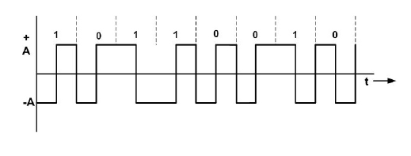
DIFFERENTIAL MANCHESTER ENCODING
There is always a transition at the middle of the bit, but the bit values are determined at the beginning of the bit.
If the next bit is 0, there is a transition.
If the next bit is 1, there is none.
.

Slide 20
.

Slide 21
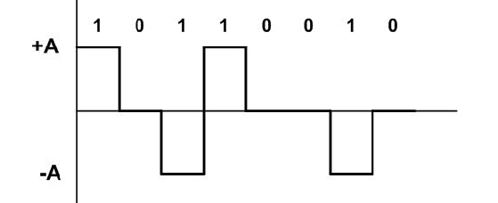
Bipolar
Bipolar AMI (Amplitude Mark Inversion)
Bipolar AMI uses 3 voltage levels.
The zero level is used to represent 0.
Binary 1’s are represented by alternating positive and negative voltage.
Loss of synchronization for long sequence of 0’s
.

Slide 22
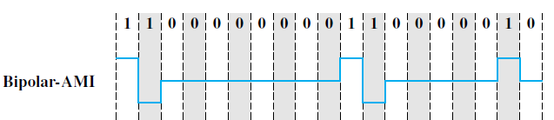
Bipolar
Bipolar AMI (Amplitude Mark Inversion)
.

Slide 23
Bipolar
Pseudoternary
Same as AMI, but alternating positive and negative pulses occur for 0 instead of 1.
.

Slide 24
Other special purpose codes
Scrambling technique.
Extension of Bipolar AMI (synchronization problems with long sequence of zero)
Examples : B8ZS, HBD3
.

Slide 25
B8ZS (Bipolar with 8 zero substitution)
Limitation of bipolar AMI is overcome in B8ZS
Which is used in north America.
Sequence of eight 0’s replaced by 000 + - 0 - + , if the previous pulse was positive.
Sequence of eight 0’s replaced by 000 - + 0 + -, if the previous pulse was negative.
.

Slide 26

B8ZS
Sequence of eight 0’s replaced by 000 + - 0 - + , if the previous pulse was positive.
Sequence of eight 0’s replaced by 000 - + 0 + -, if the previous pulse was negative
.

Slide 27

B8ZS
Sequence of eight 0’s replaced by 000 + - 0 - + , if the previous pulse was positive.
Sequence of eight 0’s replaced by 000 - + 0 + -, if the previous pulse was negative
.

Slide 28
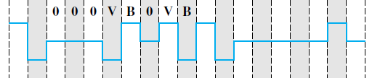
B8ZS
Sequence of eight 0’s replaced by 000 + - 0 - + , if the previous pulse was positive.
Sequence of eight 0’s replaced by 000 - + 0 + -, if the previous pulse was negative
.

Slide 29
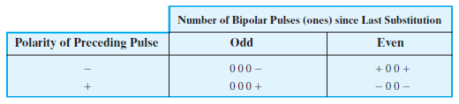
HDB3
High Density Bipolar-3 Zeros
Another alternative used in Europe and Japan
It replaces a sequence of 4 zeros by a code as per the rule given in below table.
.

Slide 30


HDB3
.

Slide 31
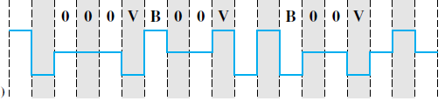
HDB3
.

Slide 32
Draw the HDB3 encoding scheme for the following bits
1100001
.

Slide 33
Draw the HDB3 encoding scheme for the following bits
111000011
.

Slide 34
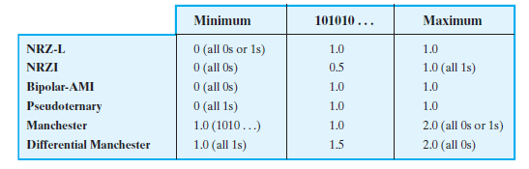
Table 5.3 Normalized Signal Transition Rate of Various Digital Signal Encoding Schemes
.

Slide 35
For the 11 bit binary string 01001100011 find the number of transitions for the following encoding schemes.
NRZ-L
NRZI
Bipolar-AMI
Pseudoternary
Manchester
Differential Manchester
.

Slide 36
For the 11 bit binary string 01001100011 find the number of transitions for the following encoding schemes.
NRZ-L 5
NRZI 5
Bipolar-AMI 7
Pseudoternary 8
Manchester 16
Differential Manchester 16
.

Slide 37
.

